Slide 1
Chapter 8 IO Organization
MPCA

Slide 2
Contents:
Serial and Parallel Communication Interfaces
Programmed IO
Interrupts: types of interrupt, Interrupt Processing, Interrupt Hardware and priority
DMA, IO processors
UART
USB and HDMI standards

Slide 3
8.1 Serial and Parallel Communication Interfaces
The serial interface acts as a communication interface between two digital systems that sends data as a series of voltage pulses over a wire.
Some devices that use the serial interface include the Universal Serial Bus (USB), Recommended Standard No. 232 (RS-232), 1-Wire and I2C.
In contrast, a parallel interface transmits multiple bits simultaneously using different wires.

Slide 4
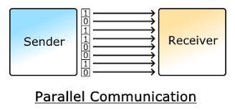
a) Parallel Communication
Parallel communication takes place when the physical layer is capable of carrying multiple bits of data from one device to another.
The data bus is composed of multiple data wires, each wire carries one of the bits.
For parallel communication, binary data of 0s and 1s are organized into a group of n bits each, And for that n bits, we need n wires, By grouping, we can send n-bits at a time. It is suitable for short distances.
Used when connecting devices reside on the same IC, or the device are on the same circuit board.
Advantages: high speed and high data rate
Disadvantages: high cost due to more communication channel.

Slide 5
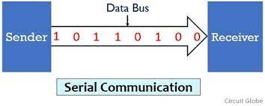
b) Serial Communication
Serial communication involves a physical layer that carries one bit of data at a time.
The data bus is composed of a single data wire, with control and possibly power wires, running from one device to another.
When data is to be sent, the sender first transmits a start bit. This start bit merely signals the receiver to wakeup and start receiving data.
The start bit is followed by N data bits, and a stop bit.
Advantage: low cost and suitable for long distance communication
Disadvantage: low speed and low data rate.

Slide 6
Serial Interface Vs Parallel Interface
Reference:
https://www.ques10.com/p/24258/what-is-difference-between-parallel-and-serial-int/

Slide 7
8.2 IO Techniques (Modes of IO transfer)
I/O operation deals with the exchanges of data between the memory and the external devices either in the direction to the memory (READ) or in the direction from the memory (WRITE).
But the problem arises on how the processor will manage the flow of data to and from the external devices in term of transfer speed, processor idle time, complexity and etc.
So in general, there are three techniques for I/O operation, which are:
Programmed I/O
Interrupt Driven I/O
DMA

Slide 8
I) Programmed I/O
In the programmed I/O method, the I/O device doesn’t have direct memory access.
The data transfer from an I/O device to memory requires the execution of a program or several instructions by CPU So that this method says Programmed I/O.
In this method, the CPU stays in a program loop until the I/O unit indicates that is ready for data transfer.
It is a time-consuming process for the CPU.
The programmed I/O method is particularly useful in small low-speed computers.
The CPU sends the ‘Read‘ command to the I/O device and wait in the program loop until it receives a response from the I/O device.
For More Understanding: https://www.youtube.com/watch?v=4SezIktwRhk

Slide 9
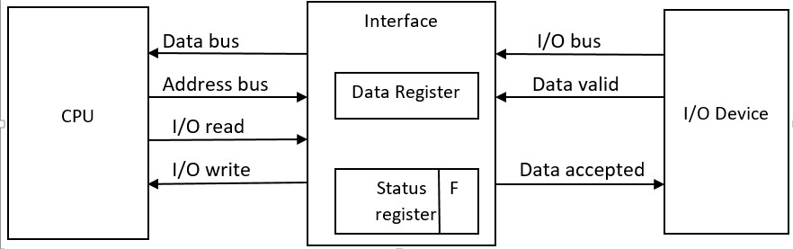
The device transfers bytes of data one at a time as they are available.
When a byte of data is available , the device places it in the I/O bus and enables its data valid line.
The interface accepts the byte into its data register and enables the data accepted line.
The interface sets a bit in the status register that we will refer to as an F or “ flag” bit.
The device can now disable the data valid line, but it will not transfer another byte until the data accepted line is disabled by the interface.

Slide 10
ii) Interrupt-initiated I/O
The problem in programmed I/O is that the CPU has to wait for the ready signal from the I/O device.
The alternative method for this problem is Interrupt-initiated I/O or Interrupt driven I/O.
In this method, the CPU issues a read command to the I/O device about the status, and then go on to do some useful work.
When the I/O device is ready, the I/O device sends an interrupt signal to the processor.
When the CPU receives the interrupt signal from the I/O device, it checks the status.
If the status is ready, then the CPU read the word from the I/O device and write the word into the main memory.
If the operation was done successfully, then the processor goes on to the next instruction.

Slide 11
iii) Direct Memory Access
Direct Memory Access (DMA) transfers the block of data between the memory and peripheral devices of the system, without the participation of the processor.
The unit that controls the activity of accessing memory directly is called a DMA controller.
The processor relinquishes the system bus for a few clock cycles. So, the DMA controller can accomplish the task of data transfer via the system bus.

Slide 12
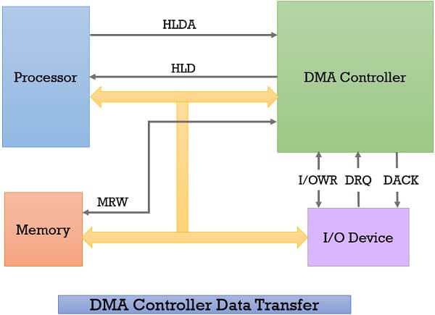
Whenever an I/O device wants to transfer the data to or from memory, it sends the DMA request (DRQ) to the DMA controller. DMA controller accepts this DRQ and asks the CPU to hold for a few clock cycles by sending it the Hold request (HLD).
CPU receives the Hold request (HLD) from DMA controller and relinquishes the bus and sends the Hold acknowledgement (HLDA) to DMA controller.
After receiving the Hold acknowledgement (HLDA), DMA controller acknowledges I/O device (DACK) that the data transfer can be performed and DMA controller takes the charge of the system bus and transfers the data to or from memory.
When the data transfer is accomplished, the DMA raise an interrupt to let know the processor that the task of data transfer is finished and the processor can take control over the bus again and start processing where it has left.

Slide 13
8.3 Interrupts and its types:
Interrupt is an external event or signal generated by I/O device to process to request for service.
Types of Interrupts: -
External Interrupts
Internal Interrupts
Software Interrupts

Slide 14
i) External interrupt
External interruptions are generated by peripheral devices, such as keyboards, printers, communication cards, etc.
The External Interrupt occurs when any Input and Output Device request for any Operation and the CPU will Execute that instructions first.
These interruptions are not sent directly to the CPU but they are sent to an integrated circuit whose function is to exclusively handle this type of interruptions.

Slide 15
ii) Internal Interrupt
As clear to its name, internal interrupts are those which are occurred due to Some Problem in the Execution.
It seems to be used mostly to refer to what are also known as exceptions: interrupts that occur in response to a processing error, such as referencing an invalid address in memory, division by zero, or similar error condition.

Slide 16
iii) Software Interrupt
A software interrupt is a type of interrupt generated by executing an instruction is called software interrupt.
A software interrupt is invoked by software, unlike a hardware interrupt, and is considered one of the ways to communicate with the kernel or to invoke system calls, especially during error or exception handling.
Software interrupts are generally used to make system calls.

Slide 17
Maskable and Non-maskable Interrupt
An interrupt that can be disabled by writing some instruction is known as Maskable Interrupt.
A non-maskable interrupt (NMI) is a hardware interrupt that standard interrupt-masking techniques in the system cannot ignore.

Slide 18
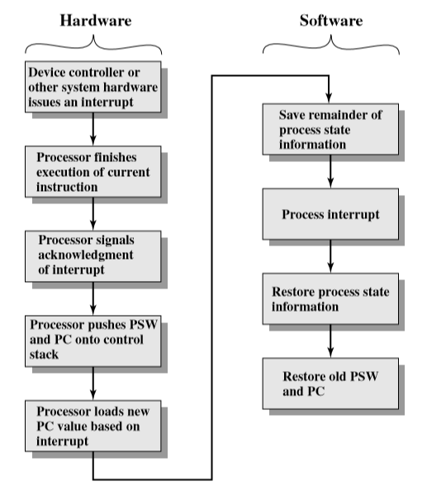
Interrupt Processing
Input output device issues the interrupts.
The Processor finishes the execution of an instruction before responding to the interrupt.
The Processor checks for an interrupt. If there is one, it then sends an acknowledgement signal to the input output device that issued the interrupt. The signal allows the device to remove its interrupt signal.
To switch to run interrupt Handler, information about the current program is stored, so that it execution maybe resumed later including Program status word(psw) and program counter(PC).

Slide 19
Interrupt Processing
The processor loads the program counter with the entry location of the interrupt Handler. Typical case is there are set of routines. Each for one type of interrupt or each for one device.
The Interrupt Handler may continue to save other information that is considered as part of process state.
The handler performs the interrupt processing.
When handler finishes, the saved Register values are stored into the registers that originally hold them when interrupt handler returns.
Finally PSW and PC values of the interrupted program are restored, thus the program may continue to execute.

Slide 20
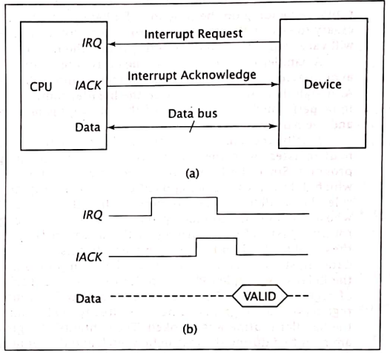
Interrupt Hardware and Priority
An external device sends an interrupt to the CPU by asserting its Interrupt Request (IRQ) signal.
When the CPU is ready to process the interrupt request, it asserts its interrupt acknowledge signal (IACK), thus informing the I/O device that it is ready to proceed.
Because its request has been acknowledged, the device sets IRQ low, which causes the CPU to set IACK low.
As the handler routine proceeds, it transfers data between the CPU and the interrupting device.

Slide 21
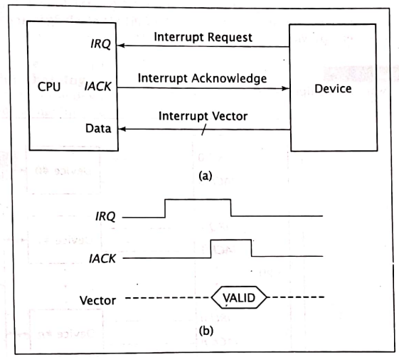
In a vectored interrupt, data is transferred later via a synchronous transfer.
A vectored interrupt is more complex.
After acknowledging the interrupt, the CPU must input an interrupt vector from the device and call an Interrupt Service Routine (ISR) handler; the address of this routine is a function of this vector.
Figure aside show a hardware block diagram and timing diagram for this system.

Slide 22
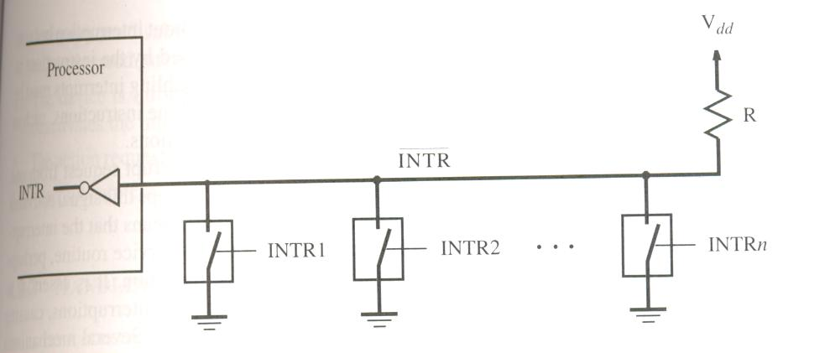
Interrupt Hardware
To request an interrupt, a device closes its associated switch, the voltage on INTR
line drops to 0(zero).
If all the interrupt request signals (INTR1 to INTRn) are inactive, all switches are
open and the voltage on INTR line is equal to Vdd.
When a device requests an interrupts, the value of INTR is the logical OR of the
requests from individual devices.
(ie) INTR = INTR1+…………+INTRn

Slide 23
Priority Interrupt
A priority interrupt is a system which decides the priority at which various devices, which generates the interrupt signal at the same time, will be serviced by the CPU.
The system has authority to decide which conditions are allowed to interrupt the CPU, while some other interrupt is being serviced.
Generally, devices with high speed transfer such as magnetic disks are given high priority and slow devices such as keyboards are given low priority.
When two or more devices interrupt the computer simultaneously, the computer services the device with the higher priority first.

Slide 24
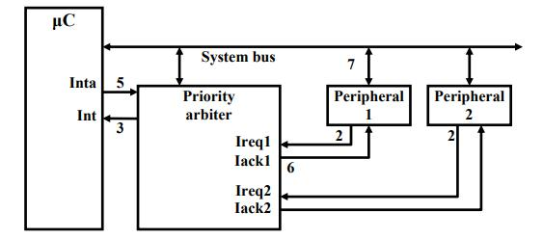
The Processor is executing its program.
Peripheral1 needs servicing so asserts Ireq1. Peripheral2 also needs servicing so asserts Ireq2.
Priority arbiter sees at least one Ireq input asserted, so asserts Int.
Processor stops executing its program and stores its state.
Processor asserts Inta.
Priority arbiter asserts Iack1 to acknowledge Peripheral1.
Peripheral1 puts its interrupt address vector on the system bus
Processor jumps to the address of ISR read from data bus, ISR executes and returns (and completes handshake with arbiter).

Slide 25
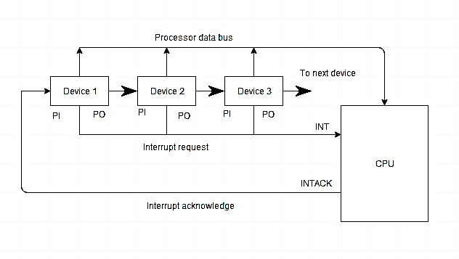
Daisy Chaining Priority
In daisy chaining system all the devices are connected in a serial form. The device with the highest priority is placed at the first position followed by lower priority devices
The interrupt line request is common to all devices.
When there is no interrupt, the interrupt line (i.e. Interrupt request) stays in high level state.
If any device has interrupt signal in low level state then interrupt line goes to low level state and enables the interrupt input in the CPU.
The CPU respond to the interrupt by enabling the interrupt acknowledge line.
This signal is received by the device 1 at its PI input.
The acknowledge signal passes to next device through PO output only if device 1 is not requesting an interrupt. (it sets PI=1 ad PO=1).
However, if the device had requested the interrupt, (PI =1 & PO = 0)

Slide 26
DMA Transfer Modes
Burst transfer mode (Block Transfer Mode)
In this mode, an entire block of data is transferred in one contiguous sequence.
Once the DMA controller is granted access to the system buses by the CPU, it transfer all bytes of data in the data block before relinquishing control of the system buses back to the CPU.
This transfer mode is needed for faster devices such as magnetic desks, where data transmission cannot be stopped or slowed down until an entire block is transformed.
Cycle stealing: -
In this mode, the DMA controller obtains access to the system buses as in the Burst mode.
However, it transfers one byte of data and then assert BR signal, returning control of the system buses to the CPU.
It continually issues requests via BR, transferring one byte of data per request, until it has transferred its entire block of data.
Transparent mode: -
In the transparent mode the DMA controller transfers data only when the CPU is performing operations that do not use the system bus.
This way the DMA transfer never interferes with the CPU executing its programs.
Disadvantage of transparent mode is: complexity of determining when the CPU is not using the system bus.
This can be inefficient in terms of overall system performance

Slide 27
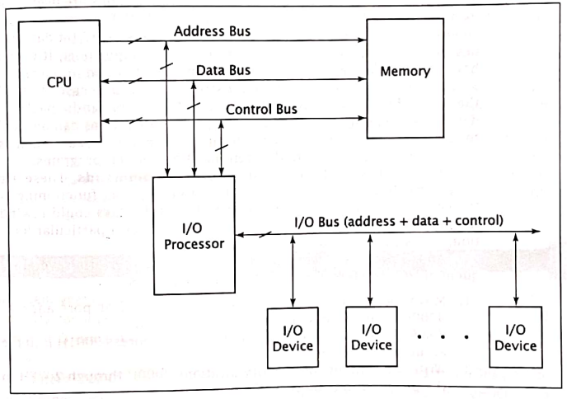
8.4 I/O processors
IO processors, sometimes also called I/O controllers, Channel controllers or peripheral processing units (PPUs)
The perform the functions of DMA controllers and much more. In fact, they usually incorporate several DMA controllers within their circuitry.
As shown in figure, the IO processor is situated between the IO devices and the rest of the system.
The IO processor, unlike DMA controller, connects to more than one IO device and coordinate transfers from several different IO devices.
It handles all of the interactions between the IO devices and the CPU.

Slide 28
8.5 Serial Communication, UART
Some devices cannot handle more than one bit of data at a time by design; they utilize serial communication.
This may be done to reduce cost or to facilitate communication with devices outside of the computer system.
In fact, CPU interacts with devices using parallel communication. So, and interface or the device itself converts the data between serial parallel forms.
Asynchronous serial communication is used to interact with devices outside of the computer, such as when connecting to another computer via modem. The connected devices do not share a common clock.
Synchronous Serial transmission is more efficient. It transmits block of data in frames, which consist of leading transmission information.

Slide 29
Serial Communication
Serial communication involves a physical layer that carries one bit of data at a time.
The data bus is composed of a single data wire, with control and possibly power wires, running from one device to another.
When data is to be sent, the sender first transmits a start bit. This start bit merely signals the receiver to wakeup and start receiving data.
The start bit is followed by N data bits, and a stop bit.
Advantage: low cost and suitable for long distance communication
Disadvantage: low speed and low data rate.

Slide 30
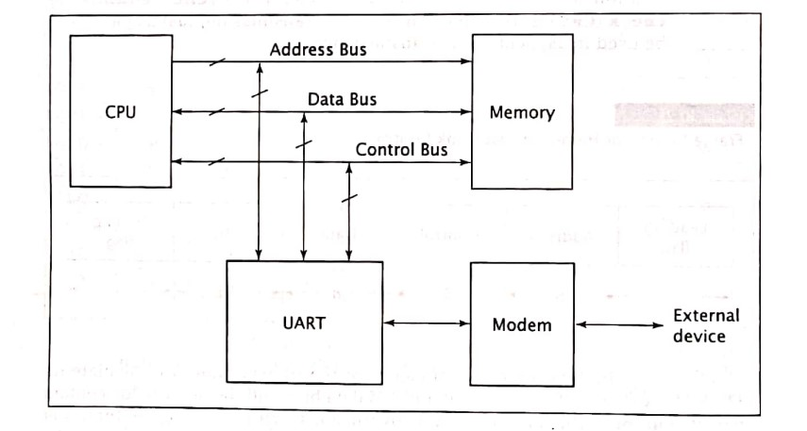
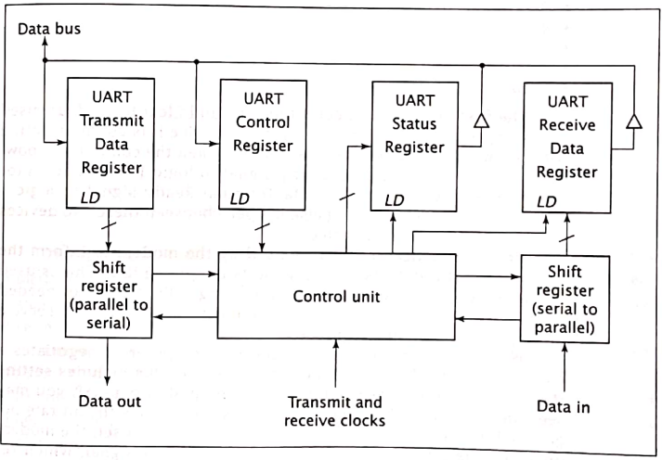

Universal Asynchronous Receiver/Transmitters (UART)
A device for asynchronous communication
UART is parallel I/O device as seen by CPU.
But it inputs and outputs data serially. It can interact with any device that can access serial data.
In given figure, UART exchange data with a modem
For transmitting data, UART O/P sequential data to modem in which modules the data, combining with carrier frequency and transmitting it.
For receiving data, modem accepts a signal at different carrier frequency and demodulates it, extracts data and transmit it serially to UART.

Slide 31
Universal Asynchronous Receiver/Transmitters (UART)
Th UART has several internal registers, just as in the DMA controller.
Like the DMA controller, the CPU treats these registers as individual IO ports.
A typical UART contains registers to hold transmitted and received data, a control register, and a status register, all of which are accessible to the CPU.
It also contains shift registers, which convert data from parallel to serial (For data transmission) and vice-versa (For data reception)
The UART’s control unit also coordinates the insertion and removal of start, parity and stop bits.

Slide 32
8.6 USB standards
USB is a specification to establish communication between devices and computer. It replace serial and parallel ports.
USB is an industry standard developed to provide two speed of operations called low speed and full speed. They provide simple, low cost and easy to use interconnection system.
Low speed- 1.5mbps
High speed- 12mbps
USB transmits data in packets. This packet can specify an address, allowing several devices to be connected to USB- port.
USB port is faster than RS-232C port.
The USB standard specifies 4 types of packets which are used to communicate between a computer and its USB peripherals.
Token packets: - It is used to initiates data transfer. It specifies address and end point for a transfer.
Data packets: - It contains data transferred to or from a device
Handshake packet: - It transfer information used to coordinate data transfers
Special packets: - It includes different other functions.

Slide 33
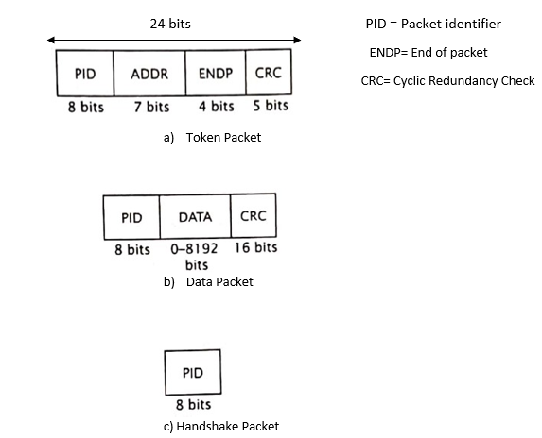

Slide 34
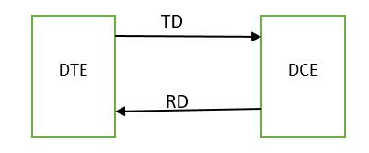
RS 232 C-standard
RS 232-C is an interface convention developed to standardize the interface between data terminal equipment (DTE) and data common equipment (DCE), serial binary data exchange.

Slide 35
RS 422A Standard:
The main problem with RS 232-C is that it can only transfer data reliably about so at a maximum rate of 20,000 Bd. This limitation is due to open signal lines with a common ground that are used for RS 232-C
RS 422A specifies that each signal will send differentially over two adjacent wires in a ribbon or a twisted pair cable. Data rates for this standard are 10 mbps for a distance of soft or 100,000 Bd for a distance of 4000ft.
It is because the differential lines are terminated by resistors so that they act as simple tx-lines of simply open wire.
For RS 422A, a logic high or 1 is indicated by B signal line being more positive than A signal line. And logic low or 0 by vice versa. The voltage difference between two lines must be greater than 0.4v but not greater than 12v.

Slide 36
8.7 HDMI standards
HDMI (High-Definition Multimedia Interface) is a proprietary specification designed to ensure compatibility between video and audio devices over a single digital interface.
The specification is used for consumer electronics -- including high-definition and ultra-HD TVs, DVD and Blu-ray players, game consoles, streaming devices such as Roku, soundbars, laptops and PCs -- as well as for automotive and commercial devices.
HDMI cables connect these devices and carry both uncompressed digital audio and video signals over a single cable.
HDMI specifications include physical features, or how cables and devices interface mechanically; electrical features, or how much power the cable carries; and communication protocols, or what signals are sent over cables to allow two pieces of equipment to communicate.

Slide 37
HDMI STANDARD | Bandwidth (up to) | AV Capabilities
Standard HDMI | 4.95Gbps | 1080p
High Speed HDMI | 10.2Gbps | 4K24 (4K 24 fps), HDR, wide colour gamuts
High Speed HDMI with Ethernet | 10.2Gbps | 4K24 (4K 24 fps), HDR, wide colour gamuts, additional Ethernet channel
Premium High Speed HDMI | 18Gbps | 4K60 (4K at 60 fps), 4:4:4 chroma sampling, 8K at lower frame rates
Ultra High Speed HDMI | 48Gbps | Uncompressed 8K video - 8K60, 4K120
Reference: https://cie-group.com/how-to-av/videos-and-blogs/hdmi-standards

Slide 38
Assignment:
Define DMA. Explain DMA different transfer modes and I/O processors in DMA.
What is arbitration? Explain Daisy chain arbitration with necessary diagram.
What is priority interrupt? How priority interrupts are handled?
How DMA is executed? Explain.

Slide 39
Exam Questions:
What are IO processors? Describe how they work using suitable diagram. [PU 2017 Fall]
What is DMA? Describe how they work using suitable diagram. [PU 2017 Spring]
Differentiate between: [PU 2018 Fall]
Interrupt driven IO and Programmed IO
Vectored and Non Vectored Interrupt Hardware.
Why do we need input output module? Compare programmed IO, interrupt driven data transfer and Direct Memory Access (DMA). [PU 2020 Spring]
What is DMA? Describe how it works. [PU 2018 Spring]
Write Short notes on:
Interrupt Vector [PU 2018 Spring]
DMA [PU 2018 Fall]
Programmed IO [PU 2017 Fall]

Slide 40
End of chapter 8

